Slide 1
SKILLS DEVELOPMENT FUND SECRETARIAT, MTHE
Sierra Leone Skills Development Project
Round 2 Call Sensitization Tour

Slide 2
Project Development Objective
To increase access to demand‐led skills training and build the foundations for a demand‐led skills development system in Sierra Leone

Slide 3
SDF Objectives
Stimulate competition and delivery of innovative program offerings;
Promote collaboration between enterprises and training centers and institutions;
Improve the efficiency of training provision;
Increase the employability of out-of-school youth; and
Increase skills acquisition among disadvantaged groups.

Slide 4
Funding Windows (1/2)
Comprises of two (2) windows:
Provider-Driven Labor Market Relevant Quality TVET (US$10.5 million – Fully Committed)
Sub window 1 – Formal TVET Institutions (Public, Private and non-profit) –US$ 7.5 million
Sub window 2- Non-formal TVET (Out-of-school unemployed or underemployed youths with focus on women and disadvantaged groups – US$ 3 million

Slide 5
Funding Windows (2/2)
(2) Support for Business in Productive Sectors (US$6 million)
Sub window 1 – Microenterprises in the informal sector (US$ 2 million)
Sub window 2- Small, medium, and large enterprises in the formal sector (US$ 4 million)

Slide 6
Target Productive Sectors
Agriculture/Agro -processing
Mining/extractives
Fisheries
Construction
Tourism
ICT

Slide 7
Expected Results
SDF aims to assist the training of 8,000 (eight-thousand people) and equip them with the necessary knowledge, skills and competency to enter and succeed in the labour market by 2024.
Among these successful graduates, 62.5% (5,000 people) should have graduated from TVET institutions supported by the SDF.
By 2024 it is also expected that 3,000 (37.5% of graduates), would have gained employment in the private sector or would have set up their own businesses, thus self-employed after graduation from the supported training programs.

Slide 8
SDF Operational Principles
Relevance of training and impact
Competitiveness
Transparency
Cost-sharing and compliant with funding rules
Focus on skills and not equipment
Improving productivity and Competitiveness
Mainstreaming gender and the disadvantaged

Slide 9
Progress from First Call

Slide 10
Concept Note to Proposal Evaluation Movement
63
Successful Proposals
110
Proposals Received
121
Concept Notes Requested to submit Proposal
286
Concept Notes Received
Concept Note received from all districts with the exception of Falaba
Your Title
Green marketing consists of marketing products and services based on environmental.
10%

Slide 11
Distribution of Selected Institutions/Businesses

Slide 12
Breakdown of Institutions Funded
Breakdown of Type of Institutions
Institution Type | No. | %
Public TVET | 20 | 32
Private TVET | 12 | 19
NGO TVET | 15 | 24
Small Formal | 10 | 16
Medium Formal | 3 | 5
Large Formal | 1 | 2
Micro -enterprise | 2 | 3
Total | 63 | 100

Slide 13
Enrolment Data
464 trainees are PWDs [325 Male (70%) and 139 (30%) Female]
Of the above enrolment, 1,070 completed training on 30th June 2021
Gender | Window 1 |  | Window 2 |  | Total | %
 | Number | % | Number | %
Male | 5,746 | 90 | 642 | 10 | 6,388 | 52
Female | 5,044 | 86 | 825 | 14 | 5,869 | 48
Total | 10,790 | 88 | 1,467 | 12 | 12,257 | 100

Slide 14
Intermediary Service Providers (ISPs)
In line with the SDF Manual, ISPs/Application Consultants were identified, through a competitive process
These consultants were accredited by the SDFS, after a 2-day engagement with the successful applicant consultants
15 experts were accredited to provide intermediary services for applicants.
42 applicants from the first call requested for ISPs
Applicants that engaged their services signed undertaking for their payment in the event they are successful

Slide 15
Independent Evaluation
15 independent evaluators were competitively recruited and drawn for various subject areas and sectors relevant to the SDF component of the SDP.
These consultants were contracted by the SDFS, after a 2-day engagement with the successful applicant consultants.
5 panels were created (22 proposals per panel)
Individual evaluations were done and followed by consensus panel discussions.
At the end of the evaluation process, 63 proposals scored 75 marks and above, and these institutions were selected for due diligence and capacity assessment.

Slide 16
Due Diligence and Capacity Assessment
The exercise commenced on the 29th September and completed 9th October.
All institutions that got the pass mark of 75 and over were visited and assessed.
The first part of the exercise, the due diligence, focused on verifying the validity of documents, ownership structure, tax records, accounting systems, procurement procedures, human resource policies, and previous grant history (If any).
The second part targeted confirmation of training location (accommodation), including adequacy for the target trainees, number of teaching and qualifications, and experience.
Their ability to manage the requested grant funding was also looked into.

Slide 17
Grant Cycle

Slide 18
Who Can Apply?

Slide 19
Window 2 (Businesses)
Be an informal sector member-based organization/association/coop or a registered company
The company/organization/coop must have been in existence for at least 2 years.
Employee/membership composition should be majority Sierra Leonean nationality.
Employee/membership composition of 25% youth and/or women.
Must be from one of the 6 targeted sectors: agriculture/agro-processing, tourism, mining/extractives, construction, fisheries and ICT.
Have demonstrable commercial viability.
The proposed training must benefit a minimum of 25 proposed trainees across the informal and formal sectors.

Slide 20
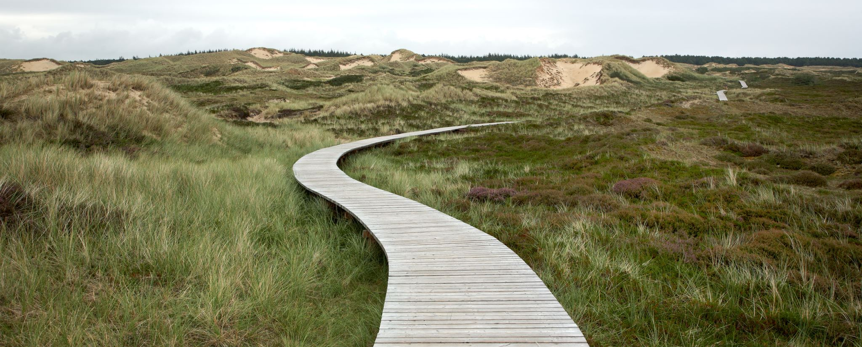
How to Apply?

Slide 21
Online
Visit the SDF Website : www.sdf.gov.sl
Submit concept note button will be active
Click on Submit Concept Note
Register your entity
Complete Form and upload required documents

Slide 22
Email
Visit the SDF Website : www.sdf.gov.sl
Download window 2 form from Resources
Complete Electronically
Email to grants@sdf.gov.sl

Slide 23
Stage 1: Concept Note Submission
Should not exceed the maximum number of characters stated in each section
Must provide basic information on the application and the project to be funded
Standard format can be downloaded or accessed from the website
Together with the concept note, the applicant must submit relevant legal documents, including evidence of registration

Slide 24
Concept Note Screening Method
As part of the screening, a preliminary due diligence of the applicant will be conducted in order to verify the de facto legal existence of the applying company/organization.
Does the application contain the required information?
Does the proposed training activity project fall within the priority sectors of SDF?
Is the applicant eligible for support according to SDF’s guidelines and target window?
Do the proposed training activities appear to be labor market relevant? .
Does the concept note indicate a gender target?
Does applicant show a good understanding of the requisite safeguard measures?
Does the indicative budget allow a realistic assessment of the likely results of the proposed activities?

Slide 25
Proposal Evaluation Summary
SUMMARY OF EVALATION GRID
# | Evaluation Area | Maximum Score
1 | Relevance of the Proposed Skills Development Initiative | 20
2 | Operational and Technical Capacity | 20
3 | Design of the Skills Development Initiative | 20
4 | Implementation Approach of the Skills Development Initiative | 20
5 | Budget, Sustainability and Impact of the Skills Development Initiative | 20
 | Total | 100

Slide 26
Contact Details and SM Platforms
Telephone: + 232 75 99 33 44
Email: info@sdf.gov.sl
Website: www.sdf.gov.sl
Facebook: Skills Development Fund Sierra Leone (SDFSL)
Instagram: sdf.sl
Twitter: @sl_sdf
Youtube link:https://www.youtube.com/channel/UCF1eU42-sEQ3pNeAZTXcD1w

